Slide 1
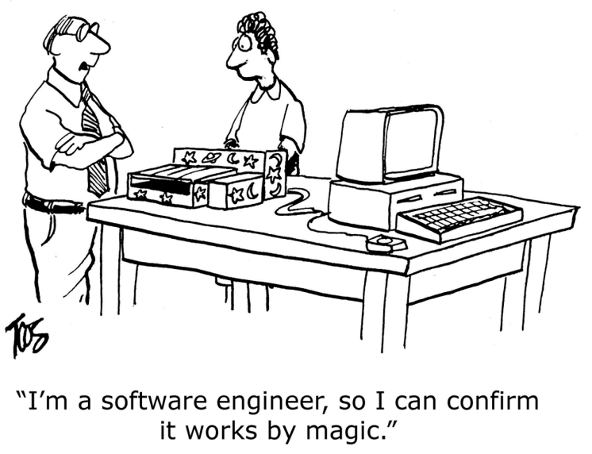
Who can Find My Devices?
Lorenzo Stigliano 185534, Crittografia Applicata 2023

Slide 2
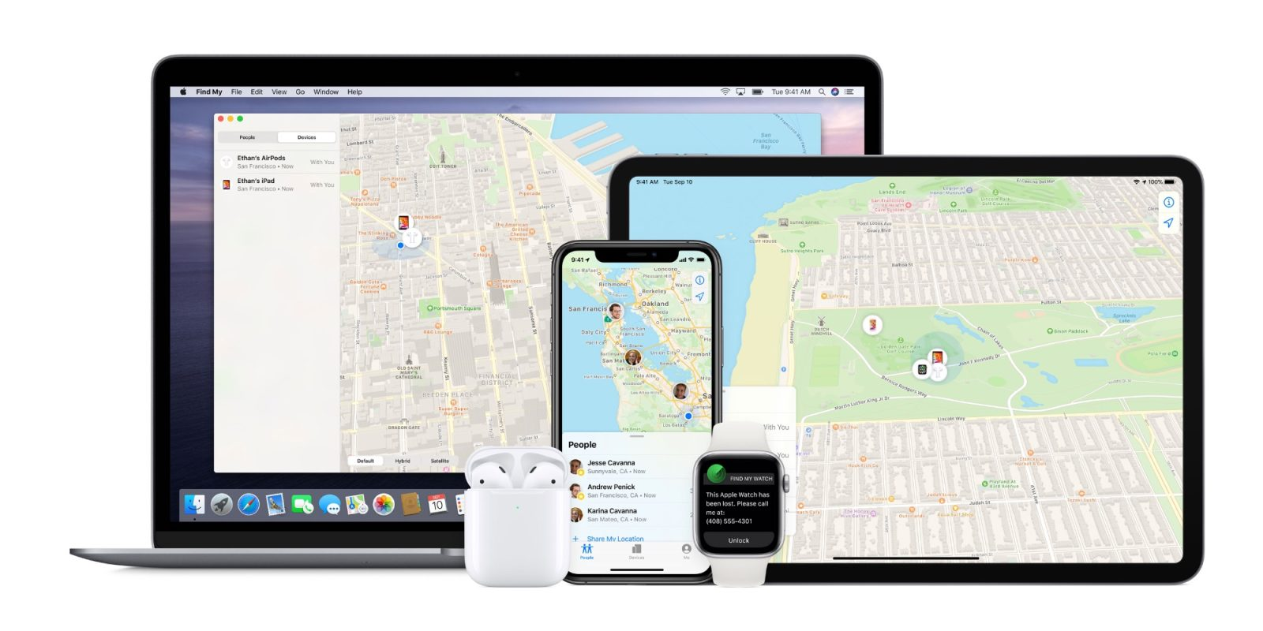
One App to find it all.

Slide 3
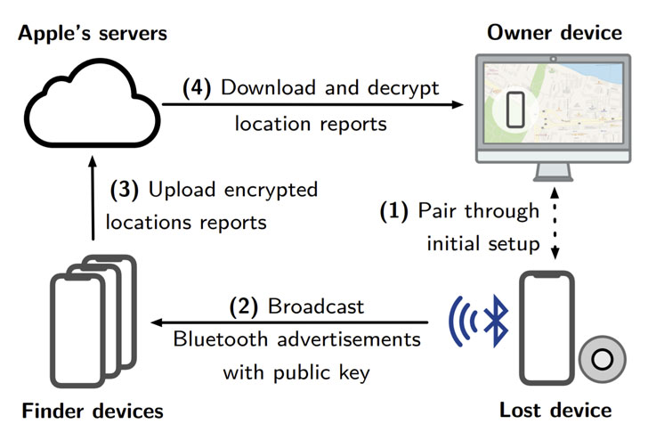
How does it work?

Slide 4
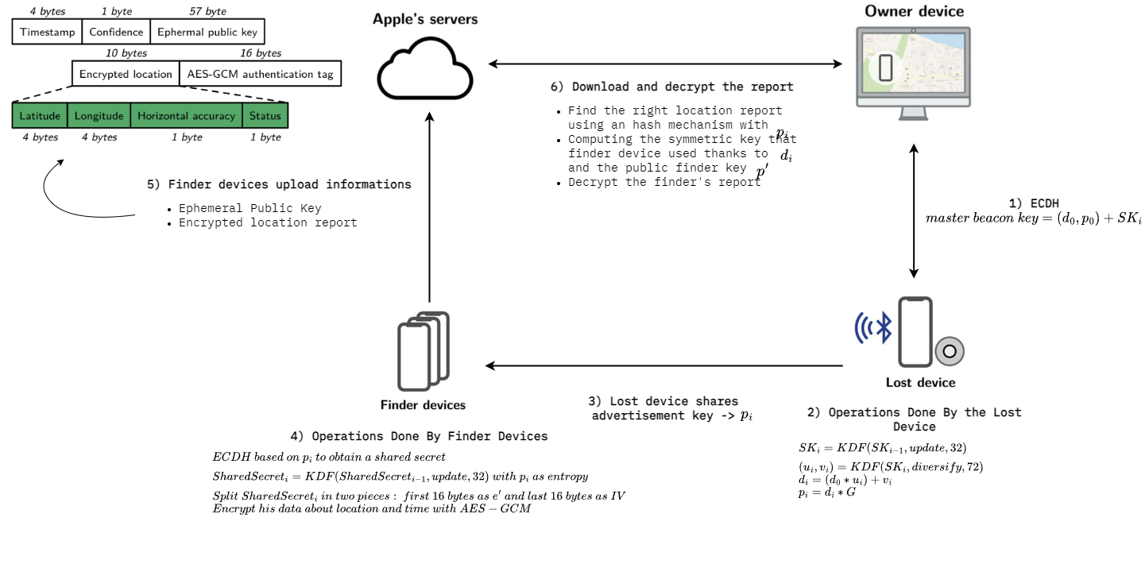
How does it work? [Detailed]

Slide 5
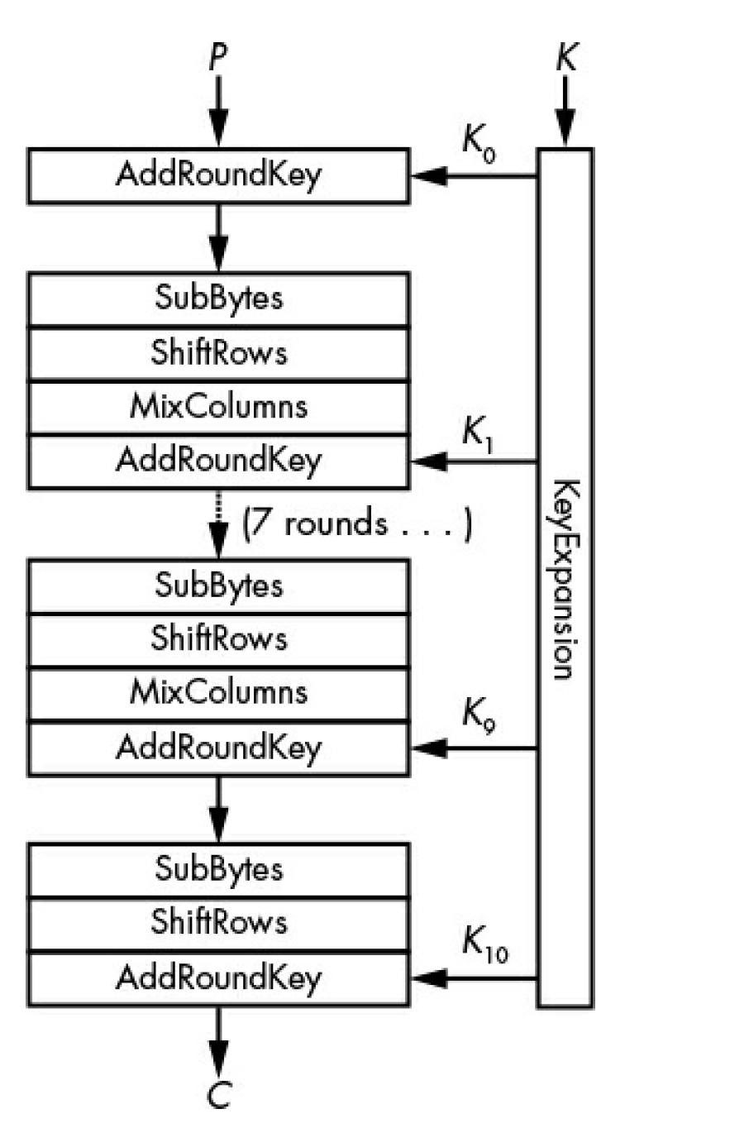
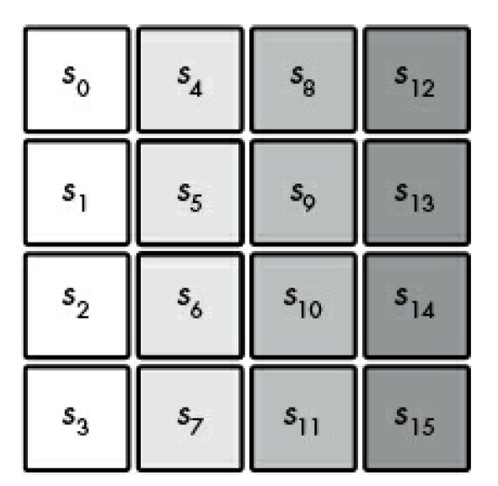
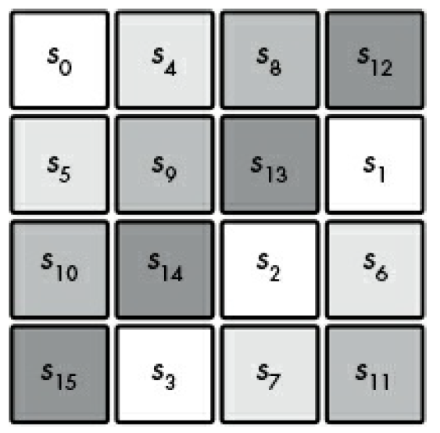
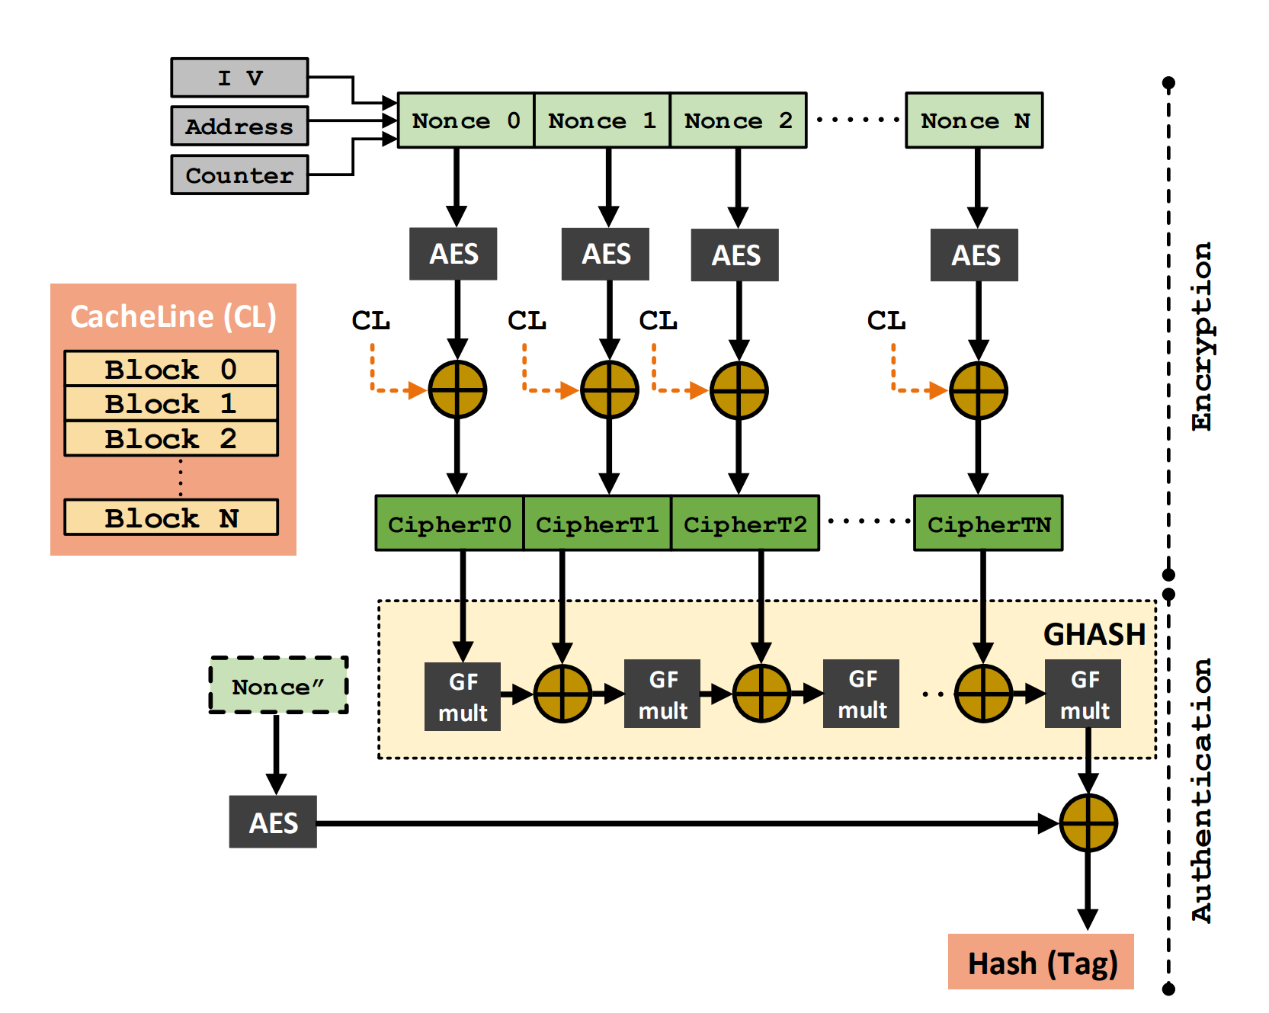
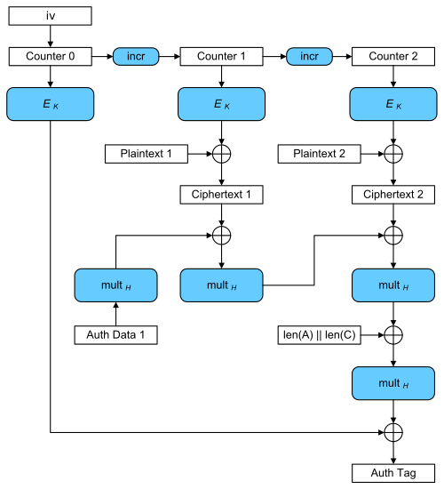
AES-GCM
Example of ShiftRows operation
GMC Internals Scheme

Slide 6
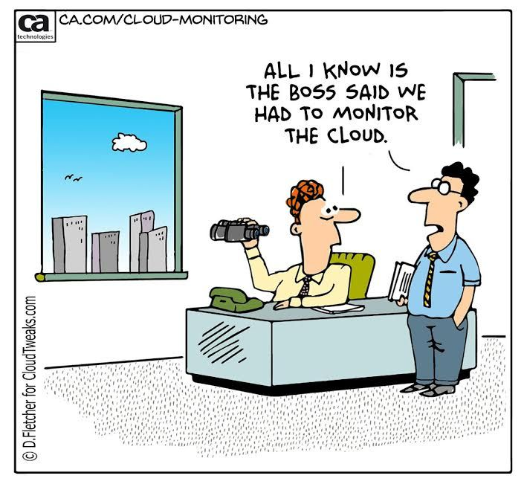
There is something missing…
How do we know the EXACT advertisement key produced by a missing device???

Slide 7

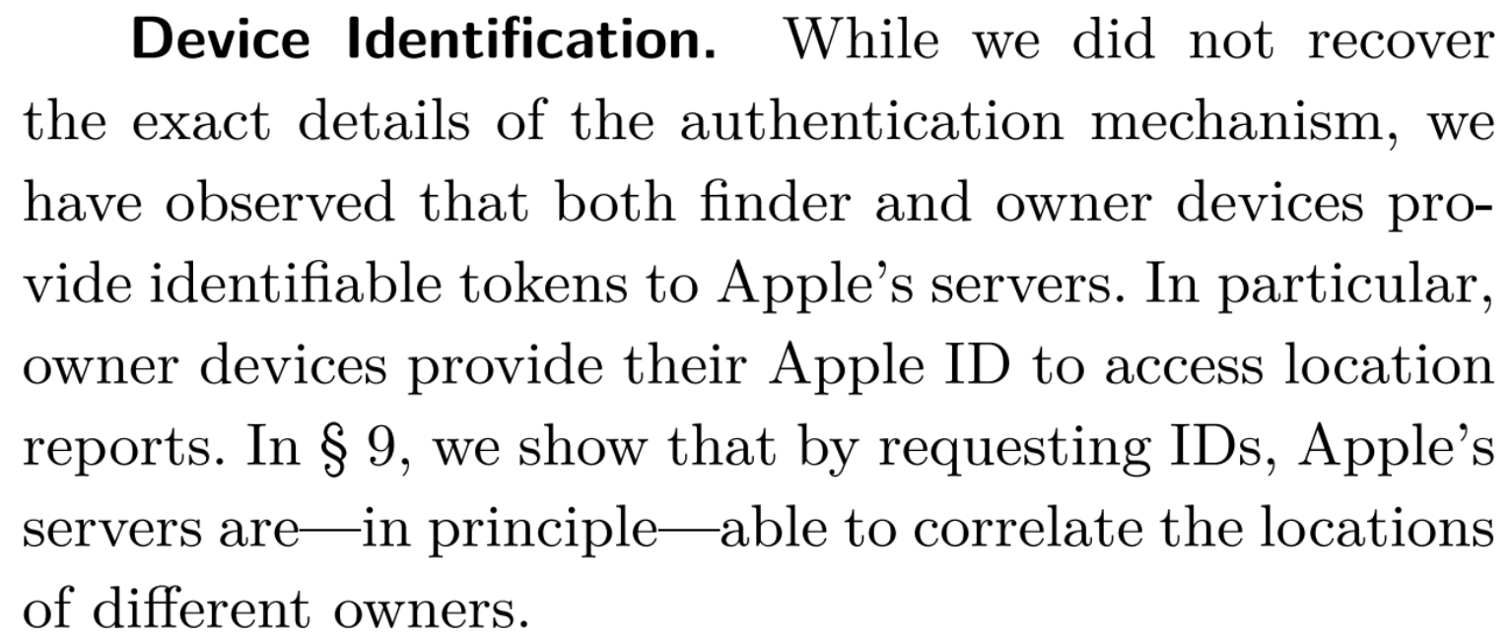
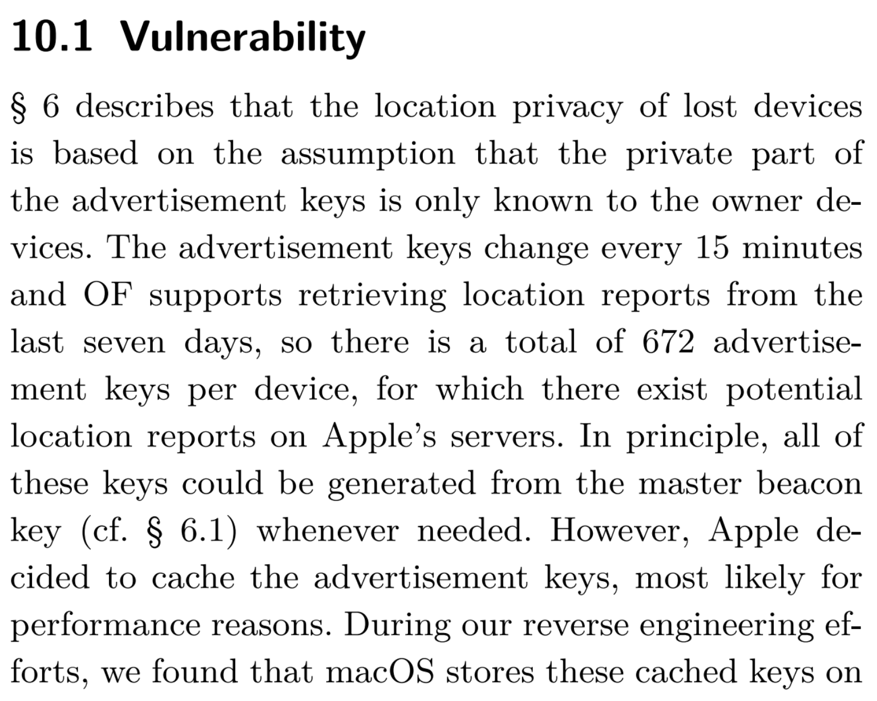
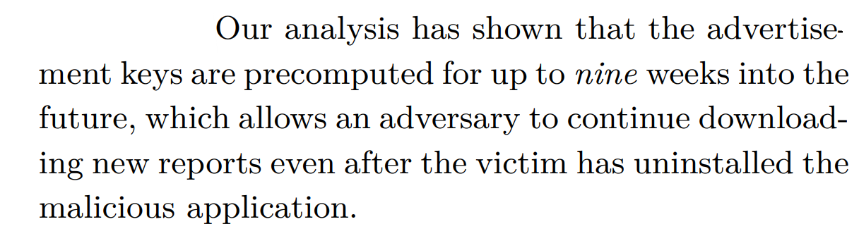
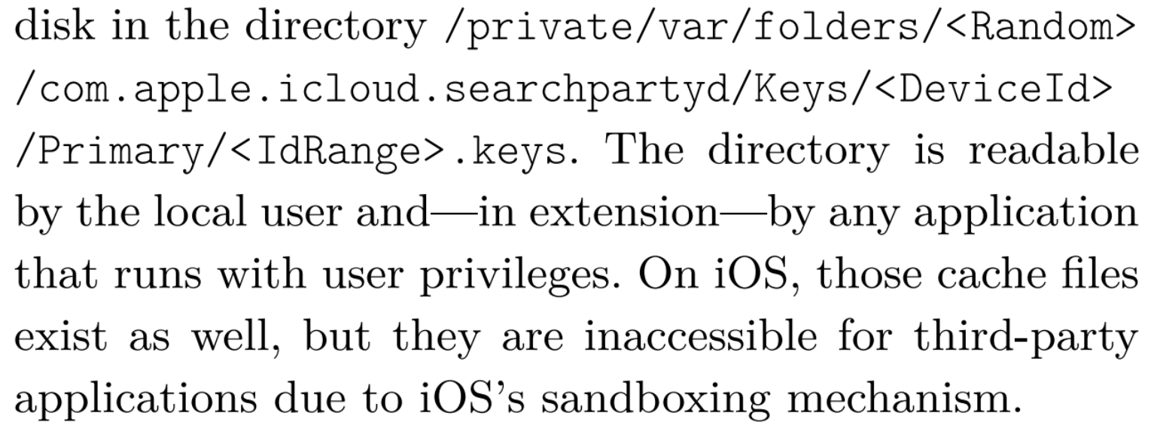











Slide 8
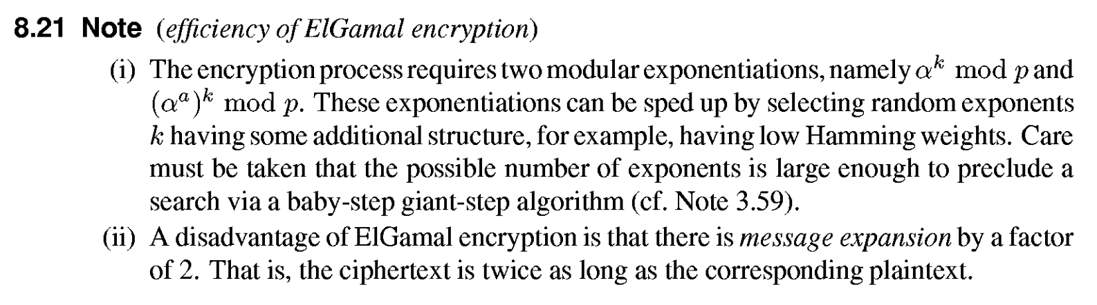
Alternatives to ECDH?
Why do we not use Elgamal??? OVERHEAD

Slide 9
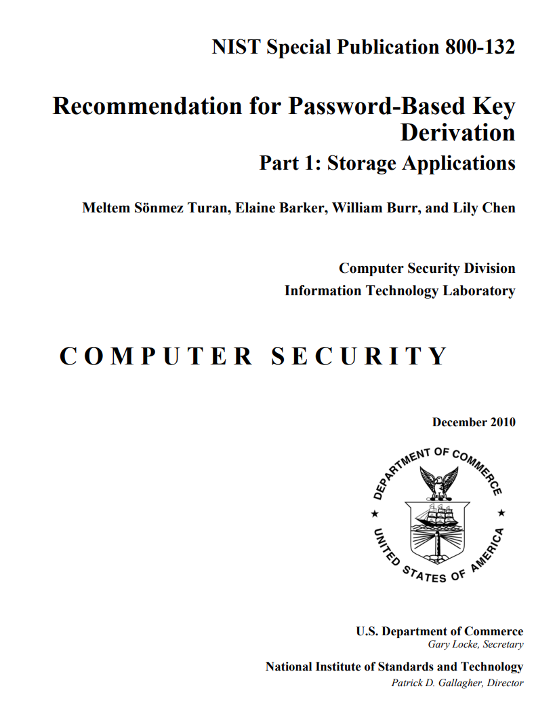
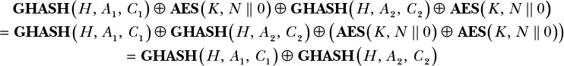
Where Things Break
Nonce repetition in AES-GCM:
If the same nonce is used twice an attacker can obtain the Hash Key!
Breaking ECDH Using Another Curve: “Say that Alice and Bob are running ECDH and have agreed on a curve and a base point, G. Bob sends his public key dBG to Alice. Alice, instead of sending a public key dAG on the agreed upon curve, sends a point on a different curve, either intentionally or accidentally. Unfortunately, this new curve is weak and allows Alice to choose a point P for which solving ECDLP is easy. She chooses a point of low order, for which there is a relatively small k such that kP = O. Now Bob, believing that he has a legitimate public key, computes what he thinks is the shared secret dBP, hashes it, and uses the resulting key to encrypt data sent to Alice. The problem is that when Bob computes dBP, he is unknowingly computing on the weaker curve. As a result, because P was chosen to belong to a small subgroup within the larger group of points, the result dBP will also belong to that small subgroup, allowing an attacker to determine the shared secret dBP efficiently if they know the order of P.” p.334, SERIOUS CRYPTOGRAPHY A Practical Introduction to Modern Encryption by Jean-Philippe Aumasson
KDF: low entropy input, extremely short salt
Using the shared secret as key session at the end of (EC)DH

Slide 10
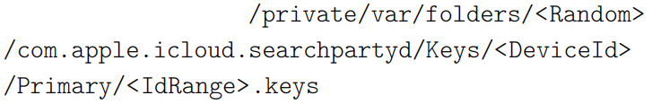
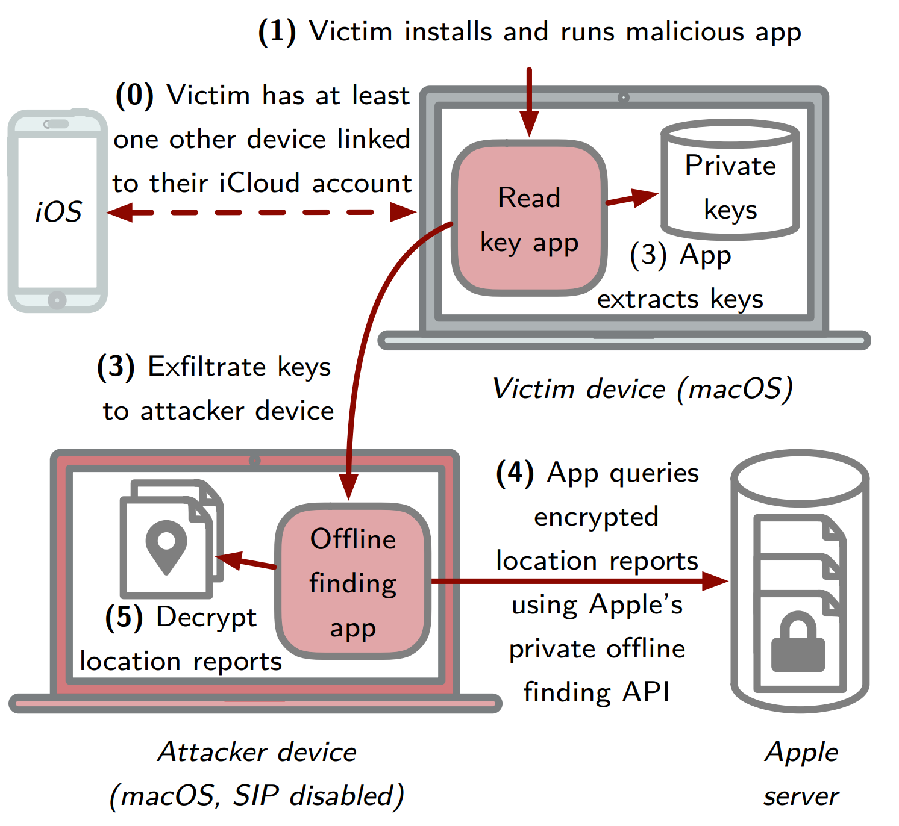
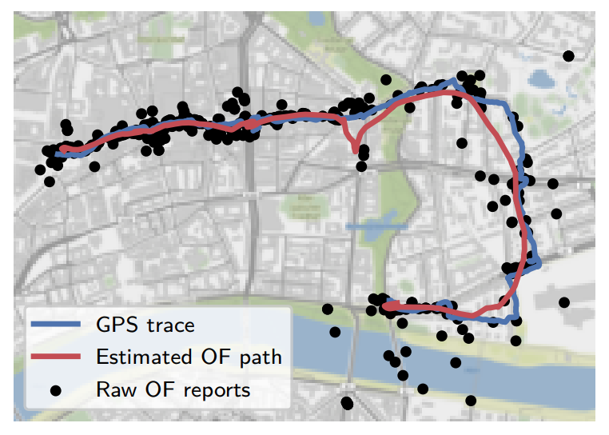
Security and Privacy Analysis
Insecure Key Storage
Unauthorized Access of Location History
Excessive advertisement keys caching: up to 9 weeks into the future
Social Tracking

Slide 11
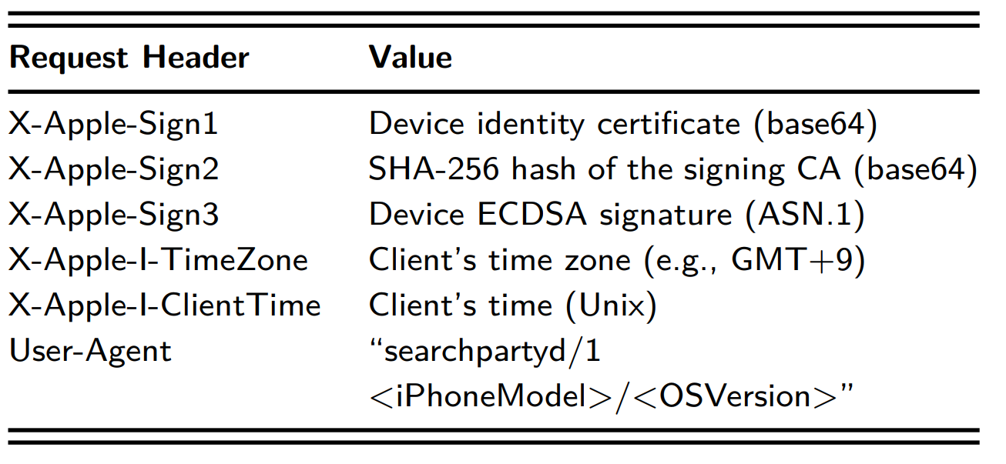
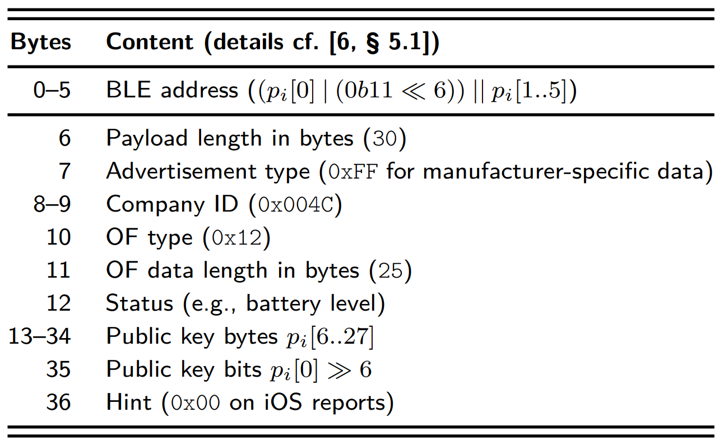
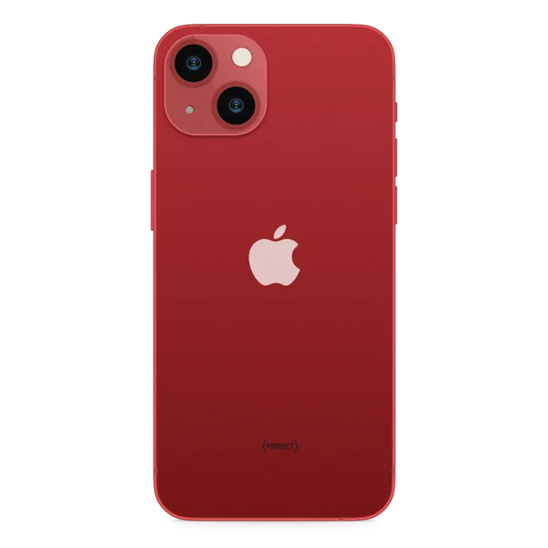
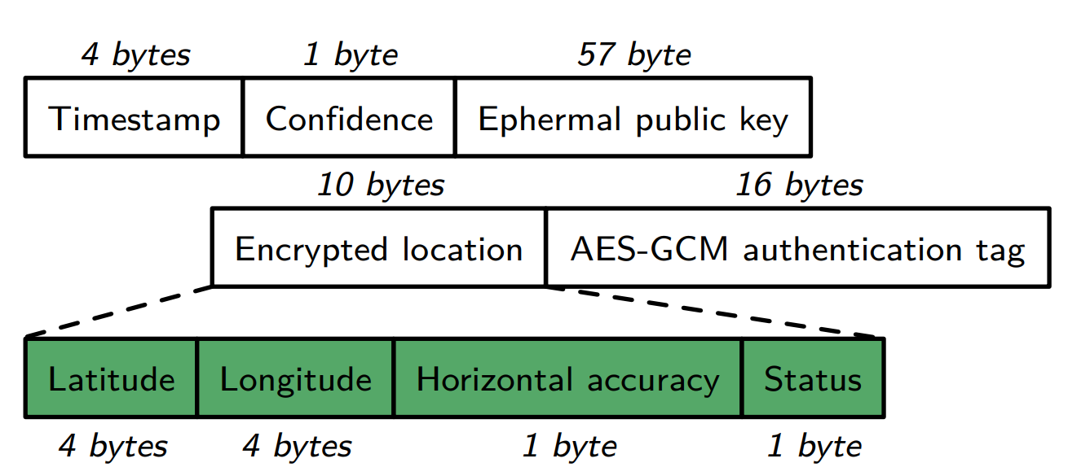
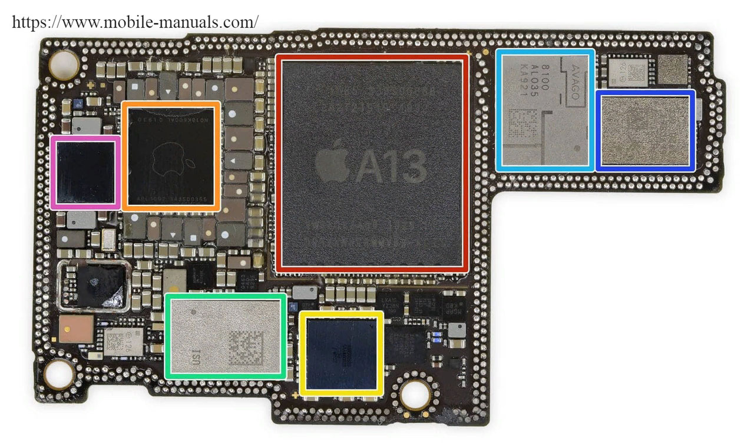


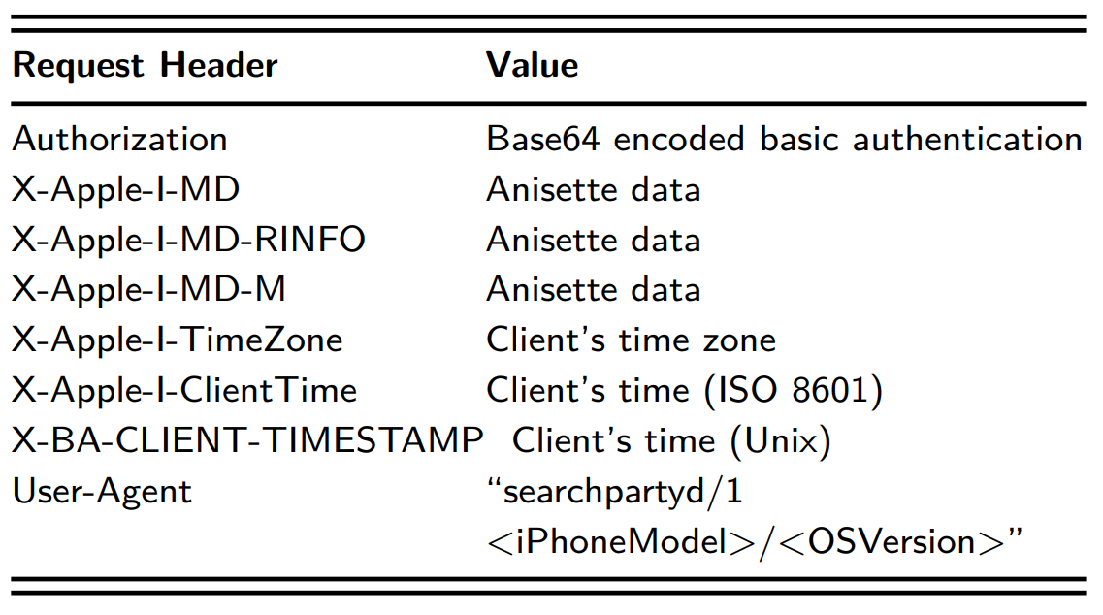
Technical Implementation
HTTP request headers for uploading location reports
Lost iPhone
Finder’s iPhone
iCloud
HTTP request headers for downloading location reports
Owner’s Laptop

Slide 12

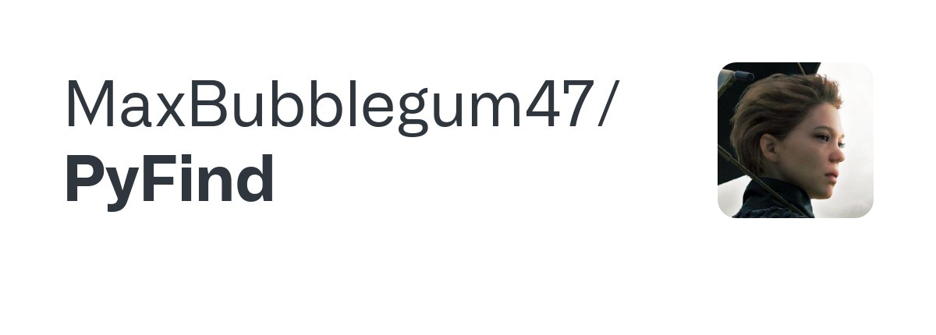
Demo Time!
Language: Python
Libraries: tinyec, cryptodome, cryptography, secrets

Slide 13
Documentation
Who Can Find My Devices? Security and Privacy of Apple’s Crowd-Sourced Bluetooth Location Tracking System (Alexander Heinrich, Milan Stute, Tim Kornhuber and Matthias Hollick)
SERIOUS CRYPTOGRAPHY A Practical Introduction to Modern Encryption (Jean-Philippe Aumasson)
(Discrete Mathematics and Its Applications) Alfred Menezes, Paul van Oorschot, Scott Vanstone - Handbook of applied cryptography
Practical Cryptography for Developers (Svetlin Nakov)
SMARTS: Secure Memory Assurance of RISC-V Trusted SoC (Ming Ming Wong, Jawad Haj-Yahya, Anupam Chattopadhyay, Nanyang Technological University (NTU) Singapore anupam@ntu.edu.s)

Slide 14
Questions?

